Slide 1

SOFTWARE ENGINEERING
UNIT V
SOFTWARE TESTING
Prof. Rahul Pawar,
Assistant Professor, School of CS & IT,
MCA Department,
Knowledge Campus

Slide 2
SOFTWARE QUALITY
Unit : V
Pressman's definition of "Software Quality“:
Software Quality is conformance to:
explicitly stated functional and performance requirements,
explicitly documented development standards,
implicit characteristics that are expected of all professionally developed software.
IEEE Definition of "Software Quality“
The degree to which a system, component, or process meets specified requirements.
2. The degree to which a system, component, or process meets customer or user needs or expectations.

Slide 3
Problems with Software Quality
Unit : V
Software specifications are usually incomplete and often inconsistent
There is tension between:
customer quality requirements (efficiency, reliability, etc.)
developer quality requirements (maintainability, reusability, etc.)
Some quality requirements are hard to specify in an unambiguous way
Directly measurable qualities (e.g., errors/KLOC),
Indirectly measurable qualities (e.g., usability).

Slide 4
Quality Attributes
Unit : V
Quality attributes apply both to the product and the process.
product: delivered to the customer
process: produces the software product
resources: (both the product and the process require resources)
Underlying assumption: a quality process leads to a quality product (cf. metaphor of manufacturing lines)

Slide 5
Unit : V
Quality attributes can be external or internal
External: Derived from the relationship between the environment and the system (or the process). (To derive, the system or process must run)
e.g. Reliability, Robustness
Internal: Derived immediately from the product or process description (To derive, it is sufficient to have the description)
Underlying assumption: internal quality leads to external quality
e.g. Efficiency

Slide 6
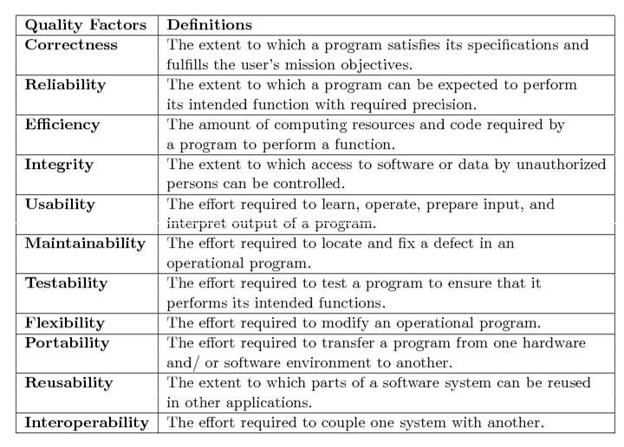
Unit : V

Slide 7
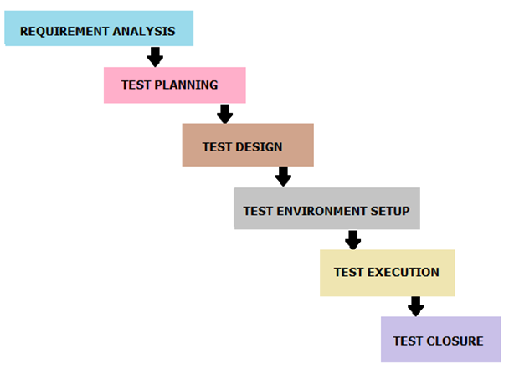
SOFTWARE TESTING LIFE CYCLE
Unit : V
STLC identifies what test activities to carry out and when to accomplish those test activities. Even though testing differs between Organizations, there is a testing life cycle.

Slide 8
Requirement Analysis:
Unit : V
Entry criteria for this phase is BRS (Business Requirement Specification) document.
During this phase, test team studies and analyzes the requirements from a testing perspective. This phase helps to identify whether the requirements are testable or not.
If any requirement is not testable, test team can communicate with various stakeholders (Client, Business Analyst, Technical Leads, System Architects etc) during this phase so that the mitigation strategy can be planned.
Entry Criteria: BRS (Business Requirement Specification) Deliverables: List of all testable requirements, Automation feasibility report (if applicable)

Slide 9
Test Planning
Unit : V
Test planning is the first step of the testing process. In this phase typically Test Manager/Test Lead involves determining the effort and cost estimates for the entire project.
Preparation of Test Plan will be done based on the requirement analysis.
Activities like resource planning, determining roles and responsibilities, tool selection (if automation), training requirement etc., carried out in this phase.
The deliverables of this phase are Test Plan & Effort estimation documents.

Slide 10
Test Design
Unit : V
Test team starts with test cases development activity here in this phase.
Test team prepares test cases, test scripts (if automation) and test data.
Once the test cases are ready then these test cases are reviewed by peer members or team lead. Also, test team prepares the Requirement Traceability Matrix (RTM).
RTM traces the requirements to the test cases that are needed to verify whether the requirements are fulfilled.
The deliverables of this phase are Test Cases, Test Scripts, Test Data, Requirements Traceability Matrix

Slide 11
Test Environment Setup
Unit : V
This phase can be started in parallel with Test design phase. Test environment setup is done based on the hardware and software requirement list.
Some cases test team may not be involved in this phase. Development team or customer provides the test environment.
Meanwhile, test team should prepare the smoke test cases to check the readiness of the given test environment.
Entry Criteria: Test Plan, Smoke Test cases, Test Data Deliverables: Test Environment. Smoke Test Results.

Slide 12
Test Execution
Unit : V
Test team starts executing the test cases based on the planned test cases.
If a test case result is Pass/Fail then the same should be updated in the test cases.
Defect report should be prepared for failed test cases and should be reported to the Development Team through bug tracking tool (eg., Quality Center) for fixing the defects.
Retesting will be performed once the defect was fixed.
Entry Criteria: Test Plan document, Test cases, Test data, Test Environment. Deliverables: Test case execution report, Defect report, RTM.

Slide 13
Test Closure
Unit : V
The final stage where we prepare Test Closure Report, Test Metrics.
Testing team will be called out for a meeting to evaluate cycle completion criteria based on Test coverage, Quality, Time, Cost, Software, Business objectives.
Test team analyses the test artifacts (such as Test cases, Defect reports etc.,) to identify strategies that have to be implemented in future, which will help to remove process bottlenecks in the upcoming projects.
Test metrics and Test closure report will be prepared based on the above criteria.
Entry Criteria: Test Case Execution report (make sure there are no high severity defects opened), Defect report Deliverables: Test Closure report, Test metrics

Slide 14
Achieving Software Quality
Unit : V
Broad activities that help a software team achieve high quality software:
Quality Assurance (QA)
establishes the infrastructure that supports solid software engineering methods, rational project management, and quality control actions
Quality control (QC)
action that helps ensure each work products meets its quality goals
e.g., review design models to ensure that they are complete and consistent

Slide 15
Unit : V
Software engineering method
understand the problem to be solved, create a design that conforms to the problems and exhibit characteristics that lead to software that are reliable, efficient, usable, etc.
Project management technique
use estimation to verify that delivery dates are achievable, schedule dependencies are understood and conduct risk planning so that problem do not breed chaos.

Slide 16
Unit : V
Testing: Strategic Approach to software Testing
Testing is the process of executing a program with the intention of finding errors.
Strategic Approach:
To perform effective testing, you should conduct effective technical reviews. By doing this, many errors will be eliminated before testing commences.
Testing begins at the component level and works "outward" toward the integration of the entire computer based system.
Different testing techniques are appropriate for different software engineering approaches and at different points in time.
Testing is conducted by the developer of the software and (for large projects) an independent test group.
Testing and debugging are different activities, but debugging must be accommodated in any testing strategy.

Slide 17
V & V
Unit : V
Verification refers to the set of tasks that ensure that software correctly implements a specific function.
Validation refers to a different set of tasks that ensure that the software that has been built is traceable to customer requirements.
Boehm [Boe81] states this another way:
Verification: "Are we building the product right?"
Validation: "Are we building the right product?"

Slide 18
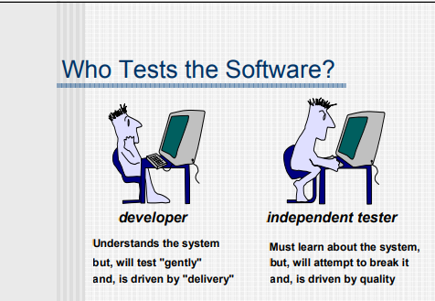
Unit : V

Slide 19
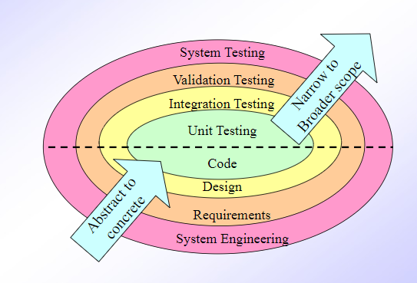
Unit : V

Slide 20
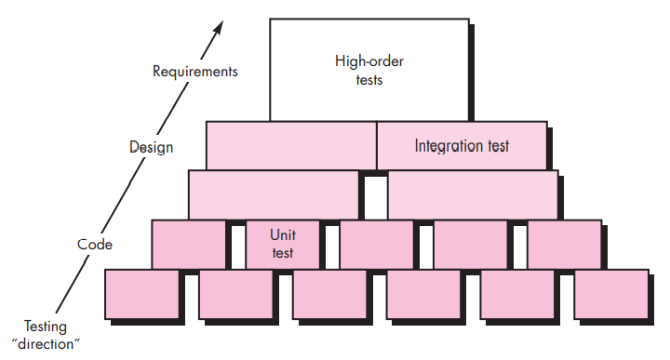
Unit : V

Slide 21
Strategic Testing Issues
Unit : V
Testing is a very important phase in software development life cycle. But the testing may not be very effective if proper strategy is not used. For the implementation of successful software testing strategy, the following issues must be taken care of: -
Before the start of the testing process, all the requirements must be specified in a quantifiable manner.
Testing objectives must be clarified and stated explicitly.
A proper testing plan must be developed.
Build "robust" software that is designed to test itself.
Use effective formal technical reviews as a filter prior to testing. For this reason, reviews can reduce the amount of testing effort that is required to produce high-quality software.

Slide 22
Unit : V
Conduct formal technical reviews to assess the test strategy and the cases themselves.
FTRs can uncover inconsistencies, omissions, and outright errors in the testing approach. This saves time and also improves product quality.
Develop a continuous improvement approach for the testing process.
The test strategy should be measured. The metrics collected during testing should be used as part of a statistical process control approach for software testing.

Slide 23
Strategies for Conventional Software
Unit : V
Following are the four strategies for conventional software: 1) Unit testing 2) Integration testing 3) Regression testing 4) Smoke testing

Slide 24
Unit testing
Unit : V
Testing focuses on individual units.
Things to consider as you write test cases for each component:
Interface to the module - does information flow in and out properly?
Local data structures - do local structures maintain data correctly during the algorithms execution?
Boundary conditions - all boundary conditions should be tested. Look at loops, First and last record processed, limits of arrays… This is where you will find most of your errors.
Independent paths- Try to execute each statement at least once. Look at all the paths through the module.
Error Handling paths- Trigger all possible errors and see that they are handled properly,
messages are helpful and correct
exception-condition processing is correct and
error messages identify the location of the true error.

Slide 25
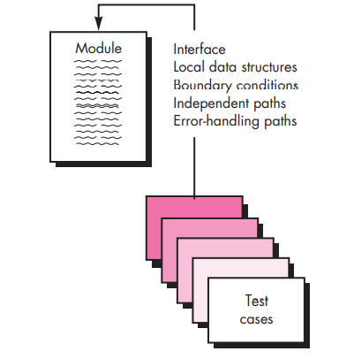
Unit testing
Unit : V

Slide 26
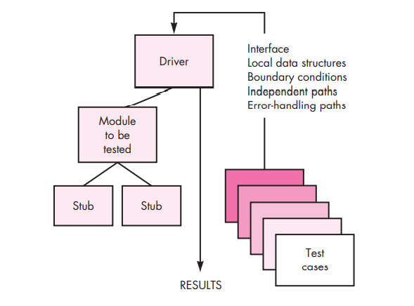
Unit testing - Environment
Unit : V

Slide 27
Unit : V
Things to consider as you write test cases for each component:
Stubs and Drivers:
Additional SW used to help test components.
Driver
a main program that passes data to the component and displays or prints the results.
Stub
a "dummy" sub-component or sub-program used to replace components/programs that are subordinate to the unit being tested.
The stub may do minimal data manipulation, print or display something when it is called and then return control to the unit being tested.

Slide 28
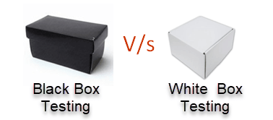
Integration testing
Unit : V
Testing focuses on the design and the construction of the SW architecture.
This is when we fit the units together.
Integration testing includes both
– verification and
– program construction.
Black-box testing techniques are mostly used.
Some white-box testing may be used for major control paths.

Slide 29
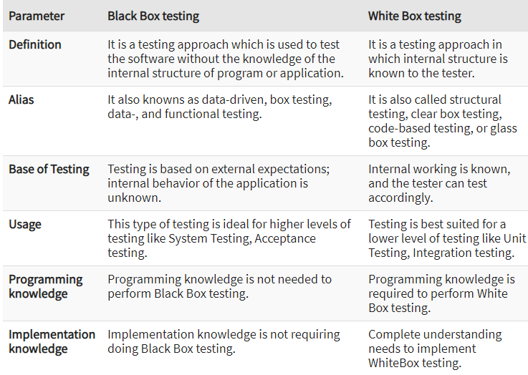
Difference between Blackbox and White Box Testing
Unit : V

Slide 30
Integration Testing
Unit : V
Bottom - up testing (test harness).
Top - down testing (stubs).
Bing Bang Approach
Sandwich/Hybrid Approach

Slide 31
Unit : V
Big Bang is an approach to Integration Testing where all or most of the units are combined together and tested at one go.
This approach is taken when the testing team receives the entire software in a bundle.
Sandwich/Hybrid is an approach to Integration Testing which is a combination of Top Down and Bottom Up approaches.

Slide 32
Top-Down Integration Testing
Unit : V
Main program used as a test driver and stubs are substitutes for components directly subordinate to it.
Subordinate stubs are replaced one at a time with real components (following the depth-first or breadth-first approach).
Tests are conducted as each component is integrated.
On completion of each set of tests and other stub is replaced with a real component.
Regression testing may be used to ensure that new errors not introduced.

Slide 33
Unit : V
Top-down testing
Integration D
Integration C
Integration B
Integration A
Stage 1
M11
Stage 2
M9
M10
Stage 3
M8
Stage 4
M6
M7
Stage 5
M1
M2
Stage 6
M3
M4
M5

Slide 34
Bottom-Up Integration Testing
Unit : V
Low level components are combined in clusters that perform a specific software function.
A driver (control program) is written to coordinate test case input and output.
The cluster is tested.
Drivers are removed and clusters are combined moving upward in the program structure.

Slide 35
Unit : V
Bottom-up testing
Stage 4
M11
Integration B
Integration c
Stage 3
M9
M10
Integration A
Stage 2
M8
Stage 1
M1
M2
M3
M4
M5
M6
M7

Slide 36
Regression Testing
Unit : V
RT is done to verify that a code change in the software does not impact the existing functionality of the product.
makes sure that the product works fine as previously with the newly added functionality or any change in the existing feature or once the bug fix is done.
Previously executed test cases are re-executed in order to verify the impact of change.
Regression means retesting the unchanged parts of the application.

Slide 37
Unit : V
Example, Consider a product X, in which one of the functionality is to trigger confirmation, acceptance, and dispatched emails when Confirm, Accept and Dispatch buttons are clicked.
Some issue occurs in the confirmation email and in order to fix the same, some code changes are done. In this case, not only the Confirmation emails need to be tested but Acceptance and Dispatched emails also needs to be tested to ensure that the change in the code has not affected them.

Slide 38
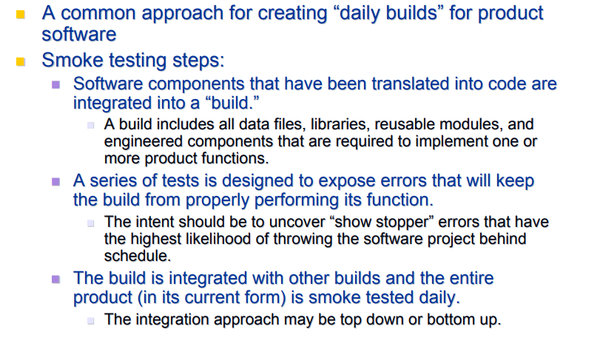
Smoke Testing
Unit : V

Slide 39
Smoke Testing
Unit : V
Smoke testing provides a number of benefits when it is applied on complex, time critical software projects
• Integration risk is minimized
- Because smoke tests are conducted daily
-show-stopper errors are uncovered early
-reducing the likelihood of serious schedule impact when
errors are uncovered
The quality of the end product is improved
-to uncover functional errors as well as architectural and
component-level design errors
-errors are corrected early, better product quality will result.
Error diagnosis and correction are simplified
- errors uncovered to be associated with “new software
increments”
Progress is easier to assess - improves team morale and gives managers a good indication that progress is being made

Slide 40
Testing Strategies for OO Software
Unit : V
Unit Testing in the OO Context
An encapsulated class is usually the focus of unit testing.
However, operations (methods) within the class are the smallest testable units.
Class testing for OO software - tends to focus on
-the algorithmic detail of a module
-the data that flow across the module interface
class testing for OO software is driven by the operations
encapsulated by the class and the state behavior of the class.

Slide 41
Testing Strategies for OO Software
Unit : V
Integration Testing in the OO Context
two different strategies for integration testing of OO systems
Thread-based testing - integrates the set of classes required to respond to one input or event for the system.
-Each thread is integrated and tested individually
-Regression testing is applied to ensure that no side effects occur
Use-Based testing
- begins the construction of the system by testing those classes that use very few (if any) server classes
- After the independent classes are tested, the next layer of classes, called dependent classes, that use the independent classes are tested

Slide 42
Testing Strategies for OO Software
Unit : V
Integration Testing in the OO Context
Cluster testing is one step in the integration testing of OO software
- a cluster of collaborating classes is exercised by designing test cases that attempt to uncover errors in the collaborations

Slide 43
Testing Strategies for Web Apps
Unit : V
The following steps summarize the approach:
The content model for the WebApp is reviewed to uncover errors
The interface model is reviewed to ensure that all use cases can be accommodated
The design model for the WebApp is reviewed to uncover navigation errors
The user interface is tested to uncover errors in presentation and/or navigation mechanics
Each functional component is unit tested.

Slide 44
Testing Strategies for Web Apps
Unit : V
Navigation throughout the architecture is tested.
7. The WebApp is implemented in a variety of different environmental configurations and is tested for compatibility with each configuration
Security tests are conducted in an attempt to exploit vulnerabilities
Performance tests are conducted
WebApp is tested by a controlled and monitored population of end users

Slide 45
Validation Testing
Unit : V
Ensure that each function or performance characteristic conforms to its specification.
Deviations (deficiencies) must be negotiated with the customer to establish a means for resolving the errors.
Configuration review or audit is used to ensure that all elements of the software configuration have been properly developed, cataloged, and documented to allow its support during its maintenance phase.

Slide 46
Validation Testing
Unit : V
The process of evaluating software during the development process or at the end of the development process to determine whether it satisfies specified business requirements.
Testing ensures that all functional, behavioral and performance requirements of the system were satisfied.
These were detailed in the SW requirements specification.
Only Black-box testing techniques are used.
The goal is to prove conformity with the requirements.
For each test case, one of two possibilities conditions will exist:
1. The test for the function or performance criteria will conform to the specification and is accepted.
2. A deviation will exist and a deficiency is uncovered.

Slide 47
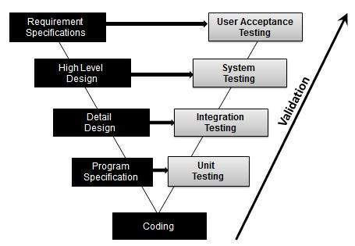
Unit : V
This could be an error in the SW or a deviation from the specification
SW works but it does not do what was expected.

Slide 48
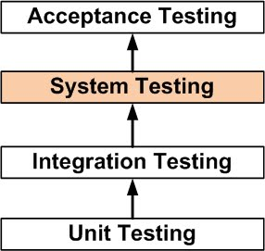
SYSTEM TESTING
Unit : V
System testing means testing the system as a whole.
All the modules/components are integrated in order to verify if the system works as expected or not.

Slide 49
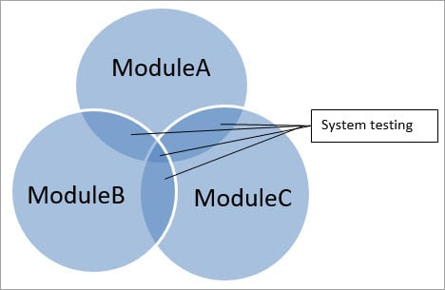
Unit : V
If an application has three modules A, B, and C, then testing done by combining the modules A & B or module B & C or module A& C is known as Integration testing.
Integrating all the three modules and testing it as a complete system is termed as System testing.

Slide 50
Unit : V
A series of tests to verify that all system elements have been properly integrated.
Recovery Testing:
Forces software to fail in a variety of ways and verifies that recovery is properly performed.
Security Testing:
is a process that is performed with the intention of revealing flaws in security mechanisms and finding the vulnerabilities or weaknesses of software applications.
Stress Testing:
Executes the system in a manner that demands resources in abnormal quantity, frequency or volume.
Performance Testing:
To test the run time performance of a system within the context of an integrated system.

Slide 51
Acceptance Testing
Unit : V
Making sure the software works correctly for intended user in his or her normal work environment.
Alpha test
version of the complete software is tested by customer under the supervision of the developer at the developer’s site
Beta test
version of the complete software is tested by customer at his or her own site without the developer being present

Slide 52
Example
Unit : V
A car manufacturer does not produce the car as a whole car. Each component of the car is manufactured separately, like seats, steering, mirror, break, cable, engine, car frame, wheels etc.
After manufacturing each item, it is tested independently whether it is working the way it is supposed to work and that is called Unit testing.
Now, when each part is assembled with another part, that assembled combination is checked if assembling has not produced any side effect to the functionality of each component and whether both components are working together as expected and that is called integration testing.
The whole car needs to be checked for different aspects as per the requirements defined like if car can be driven smoothly, breaks, gears and other functionality working properly, car does not show any sign of tiredness after being driven for 2500 miles continuously, color of car is generally accepted and liked, car can be driven on any kind of roads like smooth and rough, sloppy and straight etc and this whole effort of testing is called System testing and it has nothing to do with integration testing.

Slide 53
ART OF DEBUGGING
Unit : V
It is a consequence of successful testing - when a test case uncovers an error, it is the debugging process that results in the removal of the error.
Debugging is an ART. The external manifestation of the error and the cause of the error normally do not share an obvious relationships.
What is a BUG?
A fault in a program, which causes the program to perform in an unintended or unanticipated manner.
A program that contains a large number of bugs, and/or bugs that seriously interfere with its functionality, is said to be buggy.
Reports detailing bugs in a program are commonly known as bug reports, fault reports, problem reports, trouble reports, defect reports etc.

Slide 54
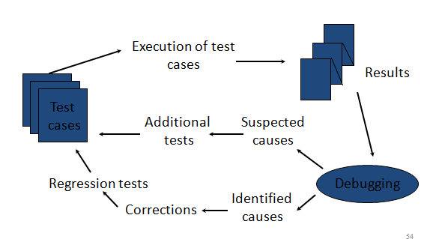
Debugging Process
Unit : V

Slide 55
Debugging Strategies
Unit : V
As debugging is a difficult and time-consuming task, it is essential to develop a proper debugging strategy.
- Brute force
- Backtracking strategy
- Cause Elimination
Brute force : most commonly used but least efficient method. Many developers rely on brute-force tactics when debugging. That involves using the debugger to step across the code from start to finish until you notice something odd.
In this method, a printout of all registers and relevant memory locations is obtained and studied. All dumps should be well documented and retained for possible use on subsequent problems.

Slide 56
Unit : V
Back Tracking Method: It is a quite popular approach of debugging which is used effectively in case of small applications.
The process starts from the site where a particular symptom gets detected, from there on backward tracing is done across the entire source code till we are able to lay our hands on the site being the cause.
Unfortunately, as the number of source lines increases, the number of potential backward paths may become unmanageably large.

Slide 57
Unit : V
Cause Elimination: It is manifested by induction or deduction and introduces the concept of binary partitioning.
This approach is also called induction and deduction..
A “cause hypothesis” is devised and the data are used to prove or disprove the hypothesis.
Alternatively, a list of all possible causes is developed and tests are conducted to eliminated each. If initial tests indicate that a particular cause hypothesis shows promise, the data are refined in an attempt to isolate the bug.

Slide 58
Unit : V
Bebugging is the process of adding known defects to the application intentionally for the purpose of monitoring the rate of detection and removal.
This process is also known as defect seeding or Fault injection or defect feeding.

